Slide 1
Ansible Workshop
Parsing Text

Slide 2
Parsing Text
Not every `show` command has a module
Commands change over time
Easier to work with data objects than searching strings

Slide 3
Parsing Engine
Ansible has a Native Parsing engine that uses:
regex - a regular expression matching syntax
YAML - human-readable data-serialization language
Can swap out and use other parsing engines if desired
textfsm / xml / pyATS are all possible parsing engines
Easier to work with data objects than searching strings

Slide 4
How it Works
Start with regex
Define each line you want to match
Use regex named capturing groups to name keys
Define data structure to output

Slide 5
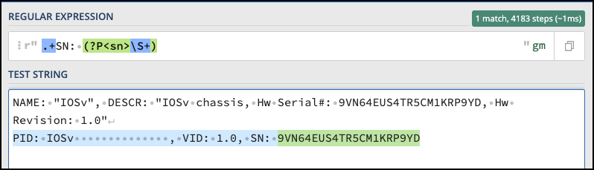
Regex
https://regex101.com/
Good source of training and a refresher
Great place to develop your regex also

Slide 6
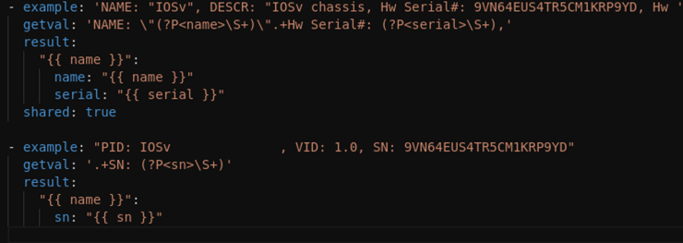
Create a Template
You will create a template that will match strings using various regex rules
Each matching line of the template will add to the output.
You can share values between matches to build complex data

Slide 7
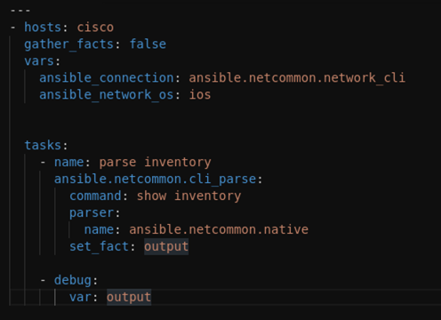
Call the Template
Call the cli_parse module
Can call IOS commands directly
Or can pass in text strings directly
Parser will look for templates based on the platform and command ran

Slide 8
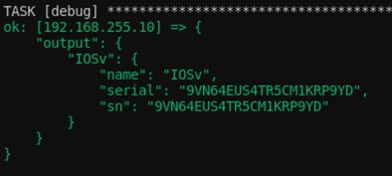
View the Output
Output is much easier to use
Can combine multiple lines into larger data structures

Slide 9
Additional Resources
Regex101 - https://regex101.com/
Parsing semi-structured text in Ansible (Ansible Documentation)
https://docs.ansible.com/ansible/latest/network/user_guide/cli_parsing.html
Ansible cli_parse document (Ansible Documentation)
https://docs.ansible.com/ansible/latest/collections/ansible/netcommon/cli_parse_module.html

